Slide 1
Windows Registry Change Monitoring System
Dhanashree Anil Jadhav
Cybersecurity Project

Slide 2
Introduction
The Windows Registry is a centralized database used by Microsoft Windows to store system settings, application configurations, startup programs, and security-related information.
Cyber attackers and malware frequently modify registry keys to establish persistence, disable security features, or execute malicious programs automatically during system startup.
This project provides a monitoring solution that continuously observes registry changes and generates alerts whenever suspicious activities are detected.

Slide 3
Abstract
Python-based toolkit that monitors registry changes, detects additions/modifications/deletions, generates alerts and maintains integrity logs.

Slide 4
Objectives
• Monitor registry keys
• Detect changes in real time
• Detect suspicious autorun programs
• Generate alerts and reports

Slide 5
Software Requirements
Windows 10/11
Python 3.x
Registry Editor (regedit)

Slide 6

Screen shots code:
Basline.py

Slide 7

Monitor.py
.

Slide 8


Slide 9
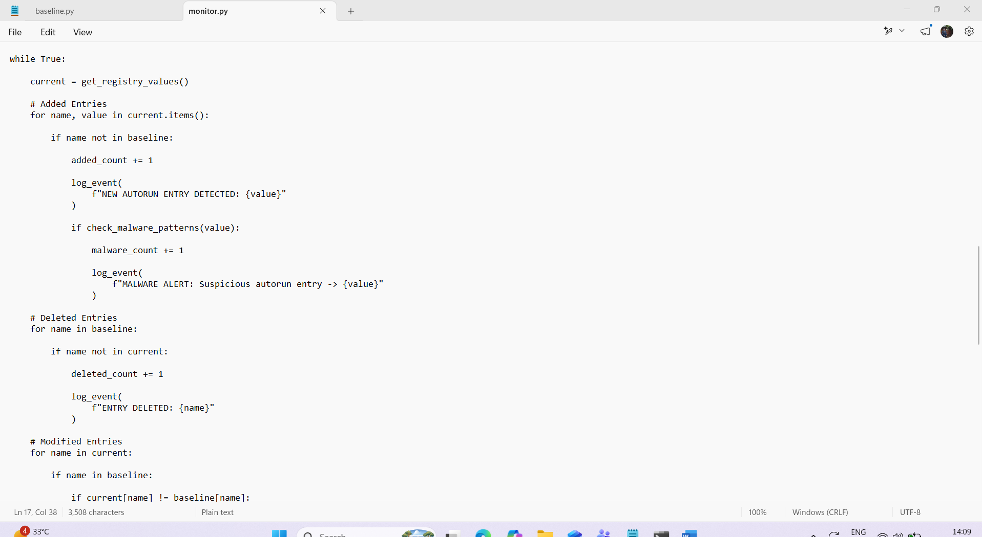

Slide 10


Slide 11


Slide 12
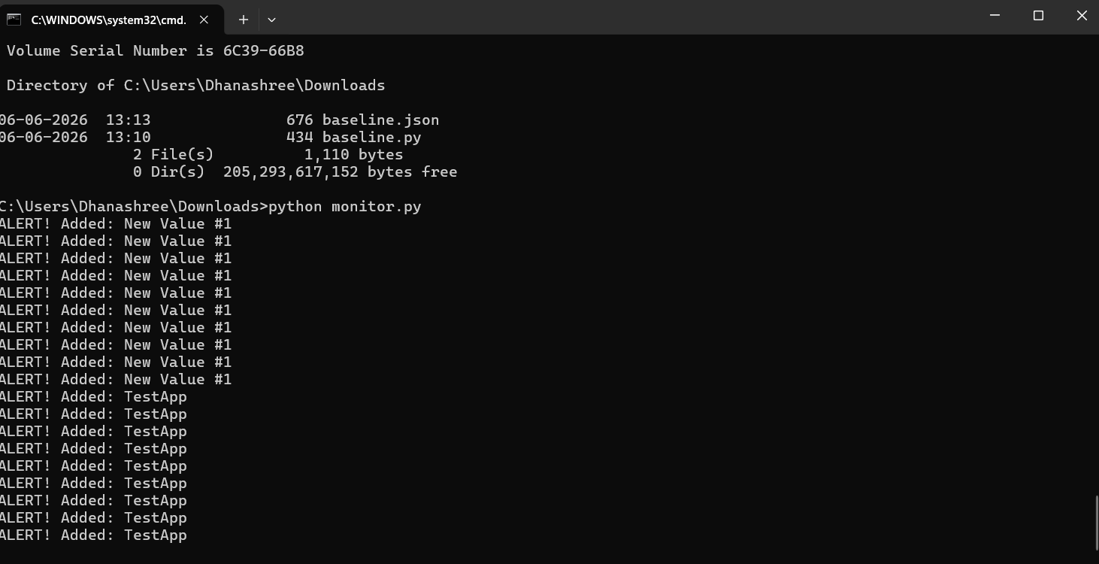
CMD:

Slide 13
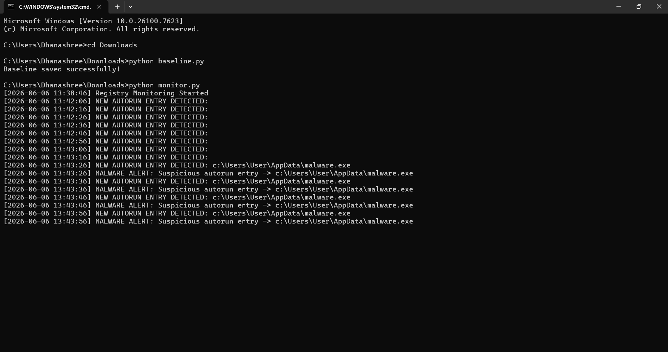

Slide 14
Registry:
HKEY_CURRENT_USER
└ Software
└ Microsoft
└ Windows
└ CurrentVersion
└ Run
Create a Test Entry
Right-click → New → String Value
Enter:
1.Name: TestApp Value: C:\Temp\TestApp.exe
2.Name: MalwareTest
Double-click it and set:
Value: C:\Users\User\AppData\malware.exe

Slide 15
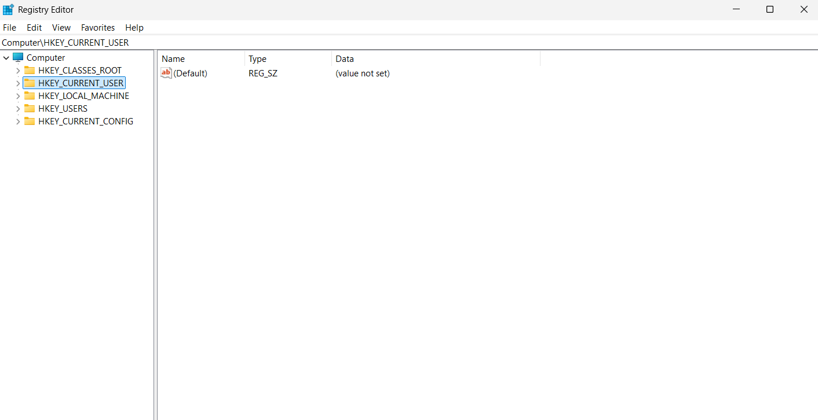

Slide 16
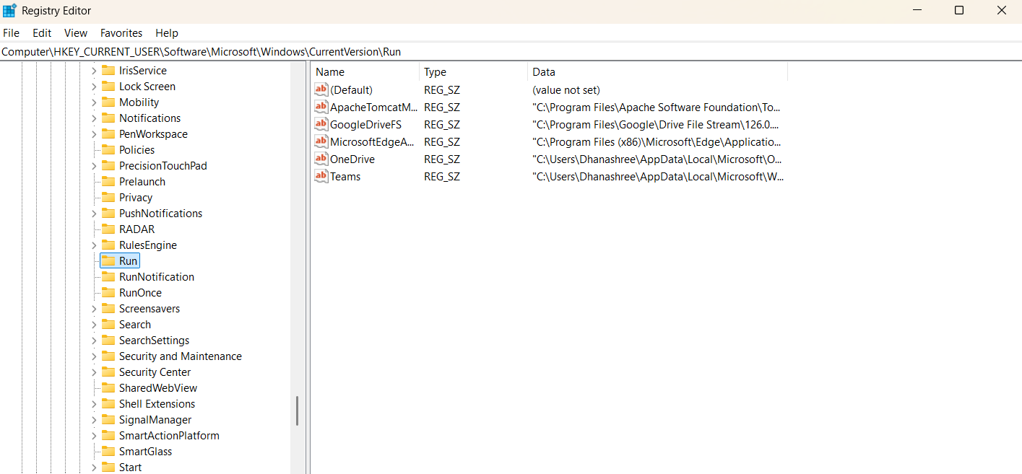

Slide 17
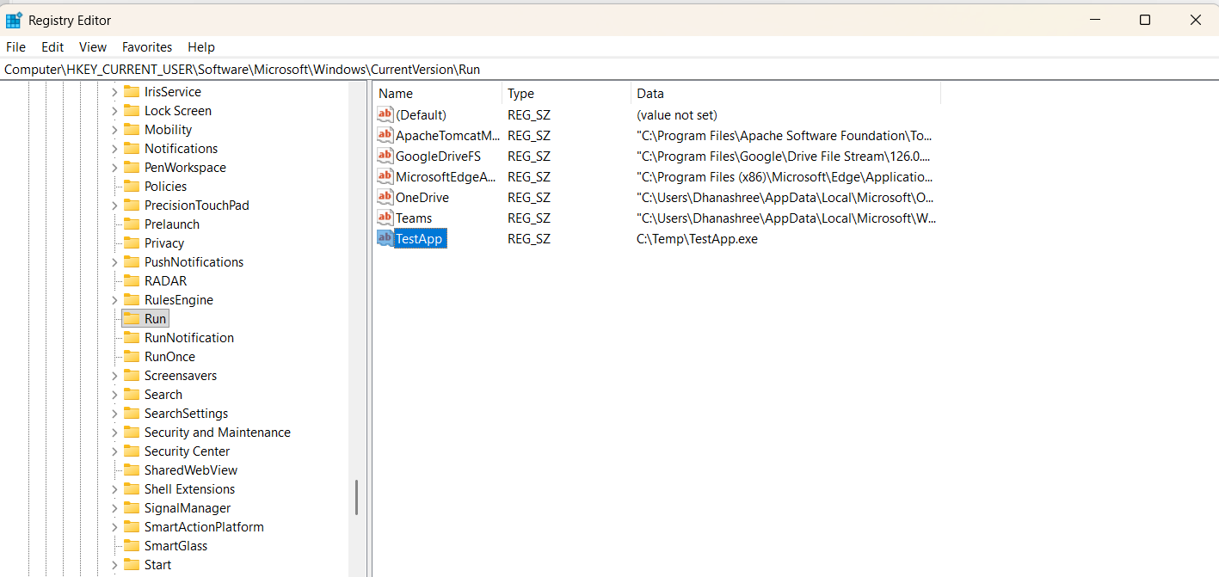

Slide 18
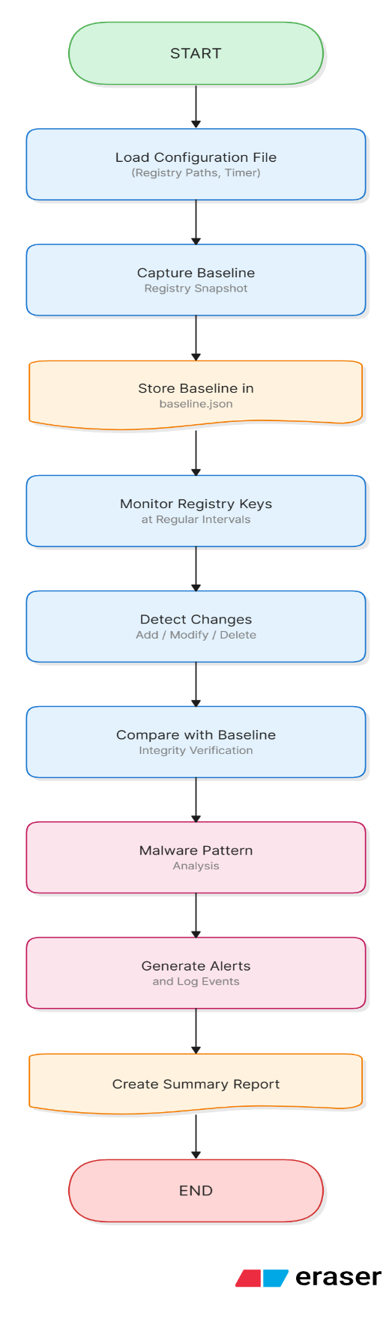
Flowchart

Slide 19
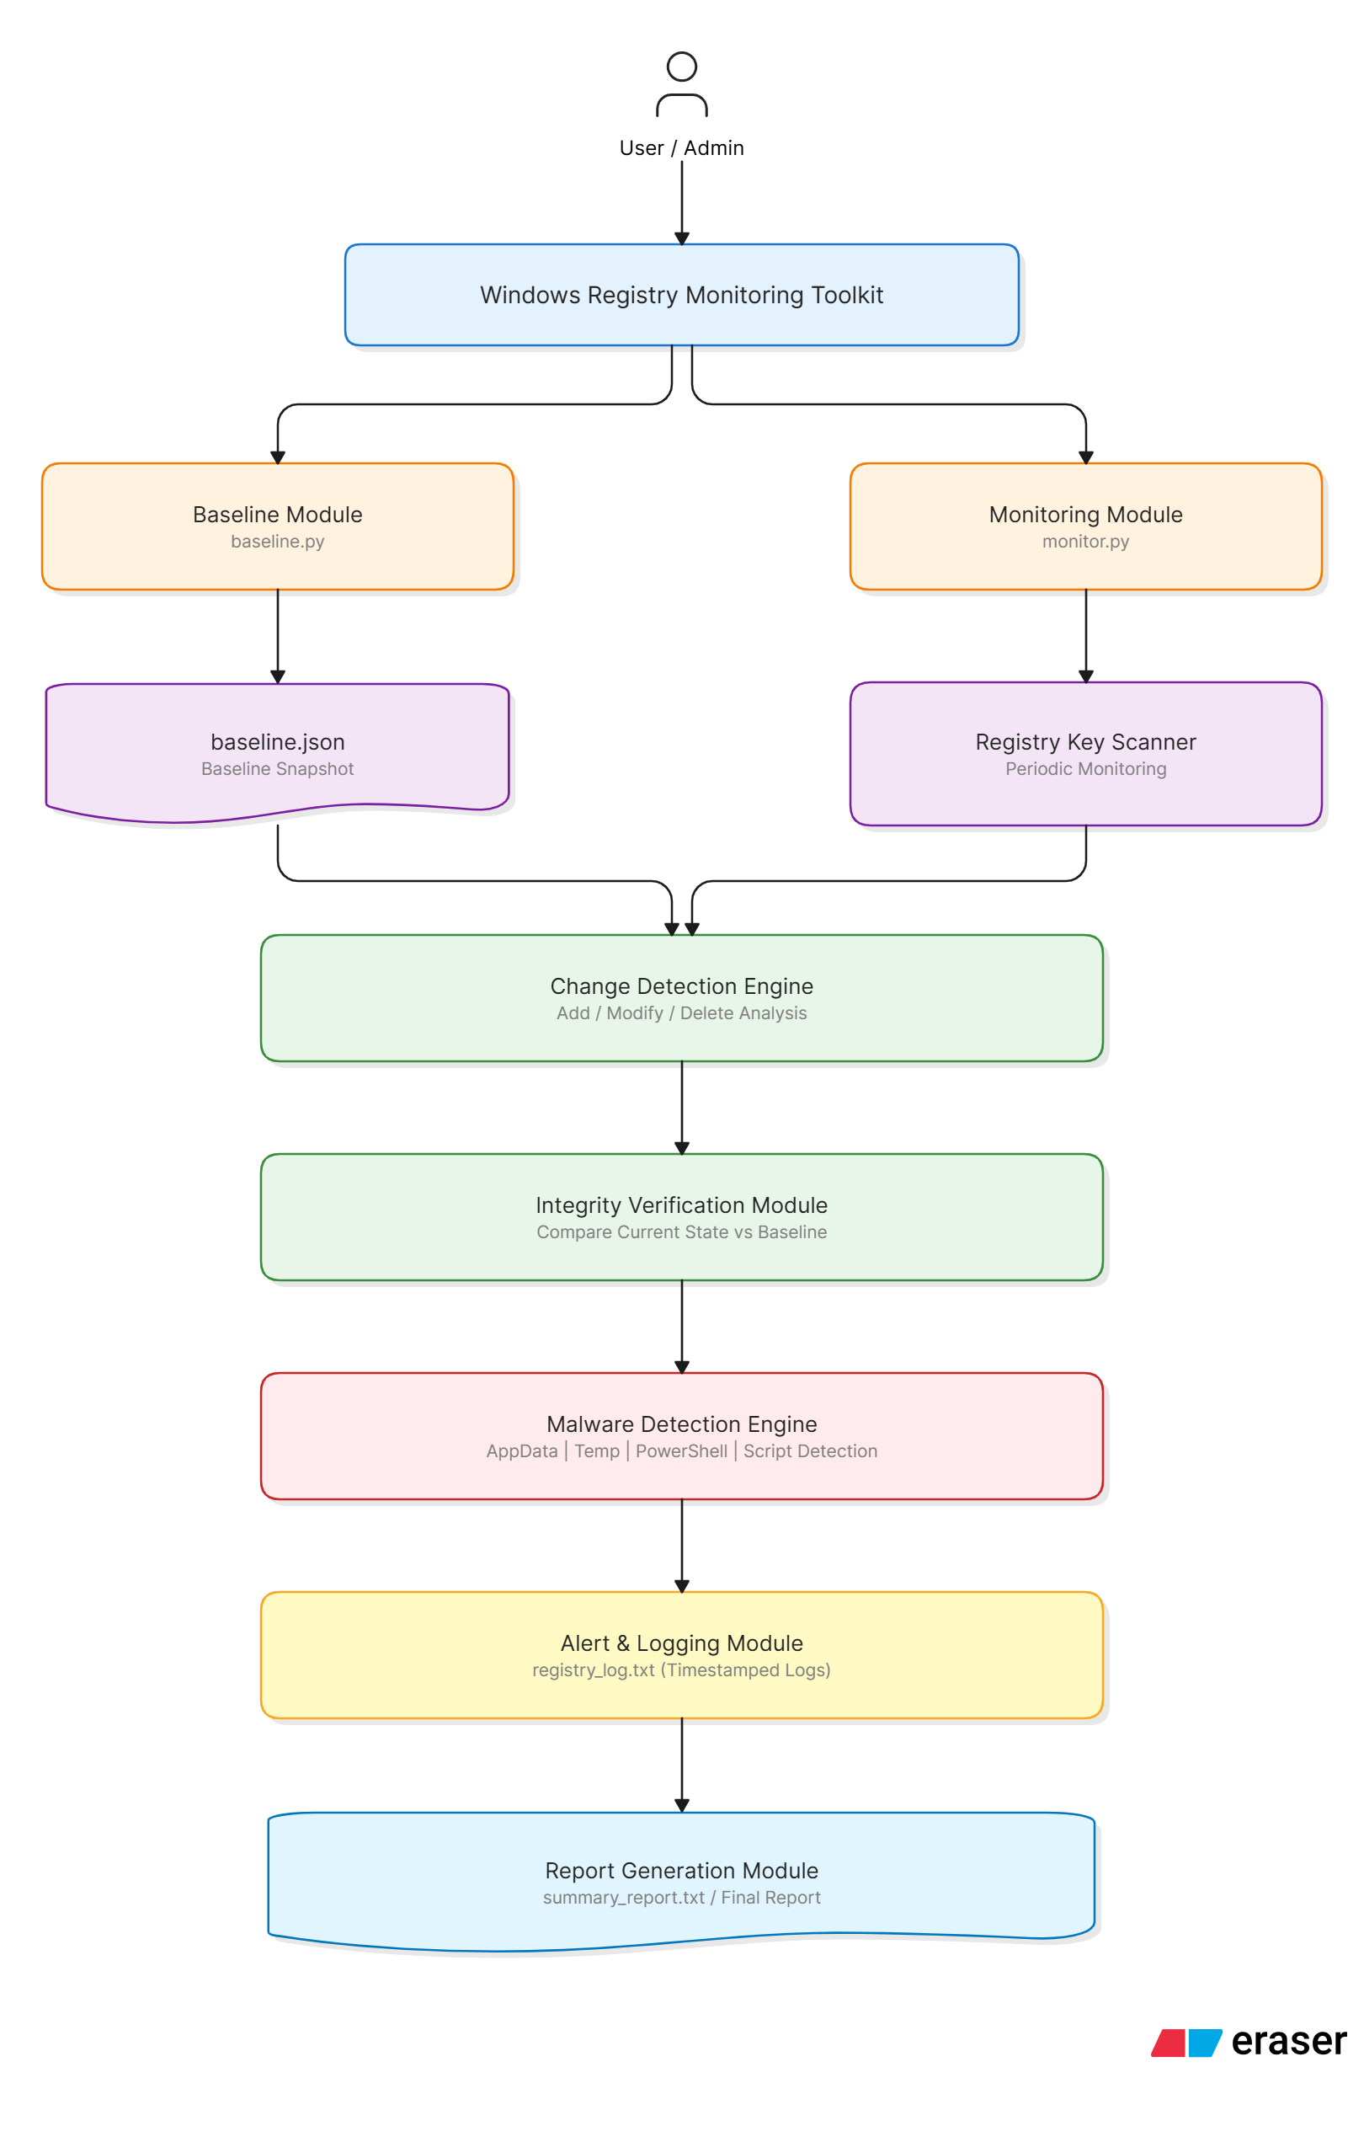
System Architecture

Slide 20
Results
The toolkit successfully:
Monitored registry changes.
Detected unauthorized modifications.
Generated malware alerts.
Performed integrity verification.
Generated reports and logs.

Slide 21
Advantages
Real-time monitoring.
Easy implementation.
Lightweight design.
Useful for malware detection.
Supports security auditing.

Slide 22
Limitations
Currently monitors only selected registry keys.
Uses periodic scanning instead of event-driven monitoring.
Limited malware signature database.

Slide 23
Conclusion
The Windows Registry Change Monitoring System successfully detects unauthorized registry modifications and suspicious startup entries. The system provides integrity verification, malware-pattern detection, logging, and reporting capabilities that assist in identifying potential security threats and maintaining system integrity.

